Slide 1
Fixed Frequency Simulator
Should generate a signal with two parts.
A noisy, ‘no signal of interest’ region composed of noisy samples distributed around ~-70 dB (which is the bottom of the noise floor of the SDR device we are using). Call this the non-key signal.
A ‘signal of interest’ which models a high power signal on a narrow frequency width. Call this the key signal.
The images on the next charts show what I have in mind. They were generated with the genQuickAndDirtySimForWes function in StreamSim.py. They were generated entirely with the defaults.
This sim is missing at least taking account of SNR (which clearly makes more sense than power) and adjustable key signal width.

Slide 2
What’s missing from your code!
Right now, it looks like it generating a noisy base signal (non-key signal) but no key signal.
Here are some suggestions:
I’ve updated the code to generate the non-key signal across the entire swept range. Now it’s not using the center frequency at all.
Add in the high-power signal. I can see where you were getting at that, but try something like this:
Freqs = np.arrange(freqLow, freqHigh, 200) # Entire swept range
signalFreqs = np.arrange(selectedFreq-1000, selectedFreq+1000, 200) #Just the high power portion
nonKeySigTransform(Freqs) #Generate the non-key signal. This is your noise line, which is good
keySigTransform(signalFreqs) #generate the high power signals on the key sig freqs
Signal = keySignal + nonKeySignal

Slide 3
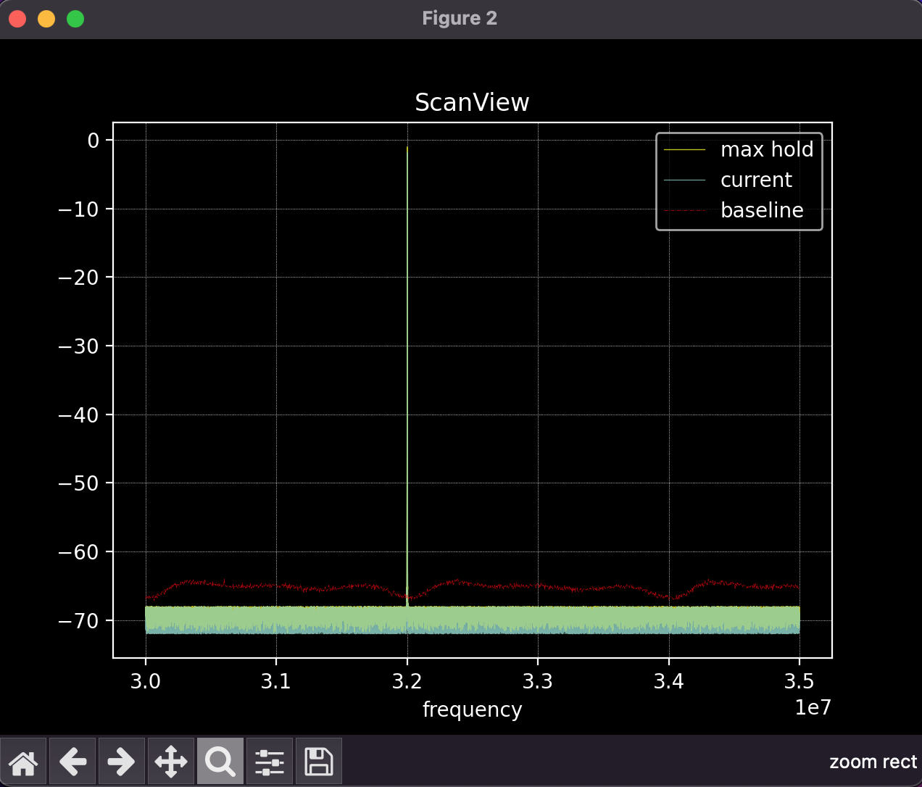
Baseline signal is in green at the bottom. The max and last measurement are basically right on top of each other, or you would see the light blue fill behind the green.
The red signal is the baseline. The baseline signal is a real signal taken with an antenna, so it’s expected to be a bit higher than our ‘no antenna’ simulation.
The signal of interest, from this perspective, almost looks like an impulse. The width of the pulse here is very narrow, only about 12.5kHz. You have to zoom in to see any of the more realistic modeling. The units are in Hz, but this goes from 30MHz to 35MHz

Slide 4
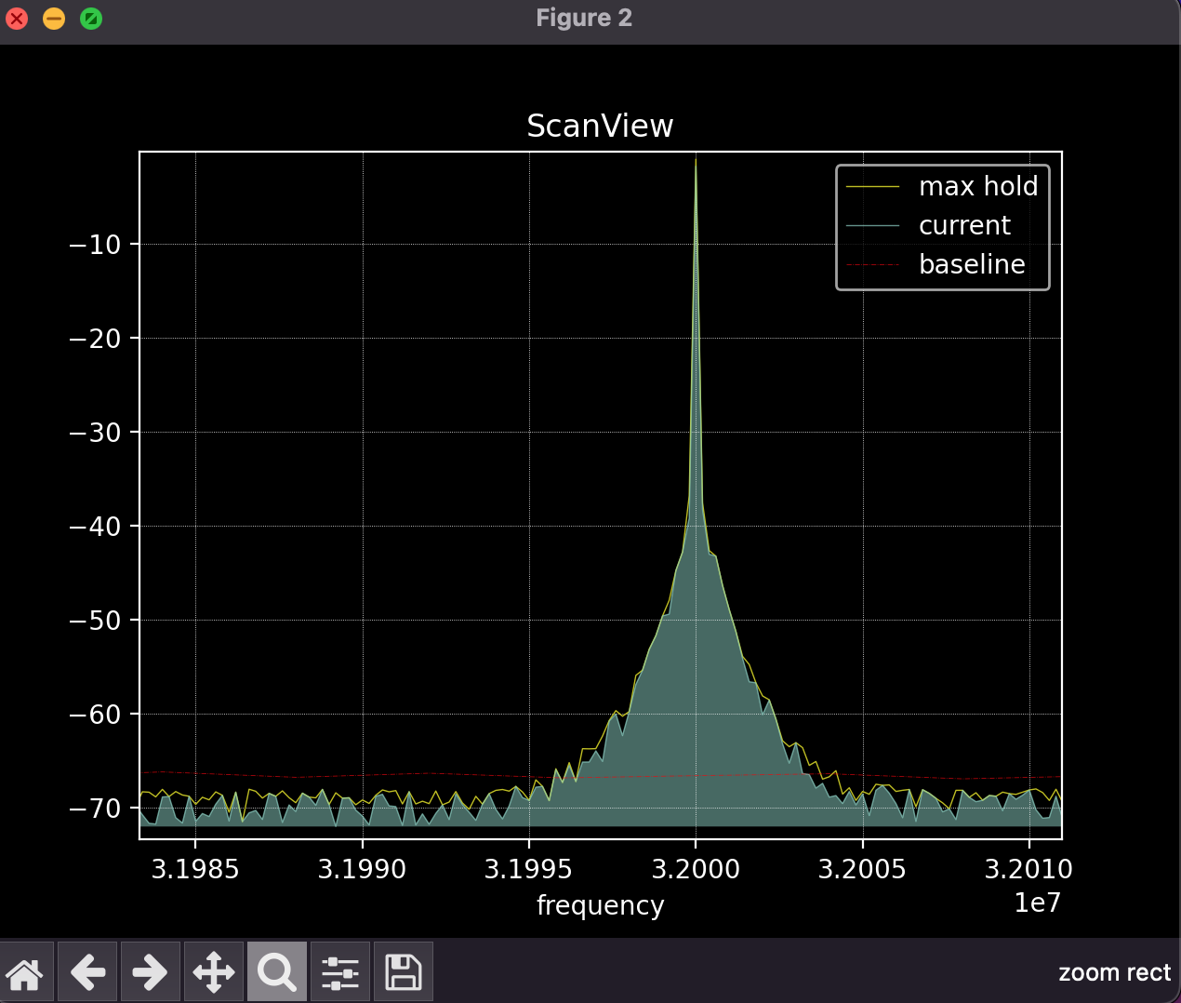
This is dramatically zoomed in. The baseline signal isn’t visible here at all. However, you can see that this simulates a channel 12.5kHz wide, the standard channel width of an FM radio station channel.

